Slide 1
Neutrons & Atomic Mass

Slide 2
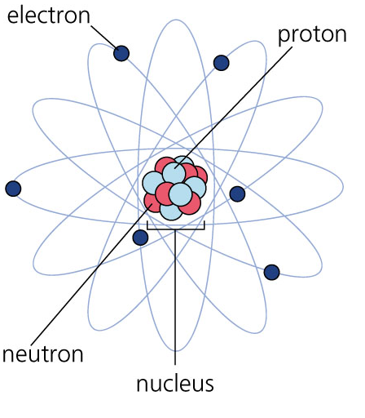
Review - Atomic Structure
Atoms consist of three different subatomic particles:
Inside the Nucleus
    Protons
    Neutrons
Outside the Nucleus
    Electrons

Slide 3
Review - Atomic Structure
Protons have a
positive charge
Electrons have a
negative charge
Neutrons have a
neutral charge

Slide 4
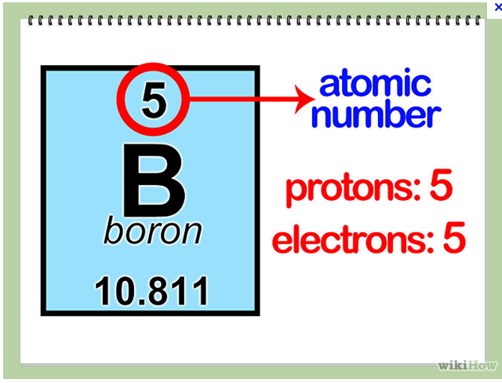
Review - Atomic Structure
The Atomic Number is same as:
  The Number of
  Protons
  The Number of
  Electrons
The Number of
Neutrons follows
a different rule

Slide 5
Neutrons
The # of neutrons is determined by:
  Rounded atomic mass - Atomic number
  Eg. Boron
    11 – 5 = 6
The # of neutrons
must be calculated
  It is not written
  with the element symbol

Slide 6
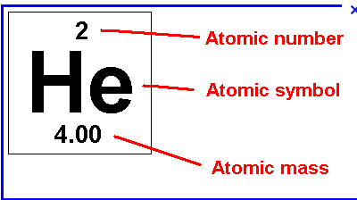
Neutrons
The # of neutrons is determined by:
  Rounded atomic mass - Atomic number
  Eg. Helium
    4 – 2 = 2

Slide 7
Standard Notations
This is another way to write out the element and all the information about it.
It contains 3 steps:
  The Symbol for the element is written out
  Then the Atomic Mass is written at the top left
  Then the Atomic Number is written at the bottom left

Slide 8
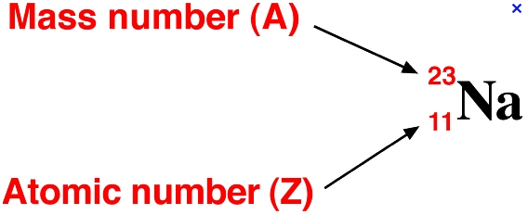
Standard Notations
This is another way to write out the element and all the information about it.
Eg. Sodium

Slide 9
Standard Notations
This is another way to write out the element and all the information about it.
You Try for Oxygen

Slide 10
Practice:
First 20 Elements Worksheet
  Now complete the Part #3 information:
      # of Neutrons and Standard Notation
  Do questions for Part #3

Slide 11
First 20 Elements Questions
Part #3
  Are the number of neutrons related to the number of protons or electrons?

